Slide 1
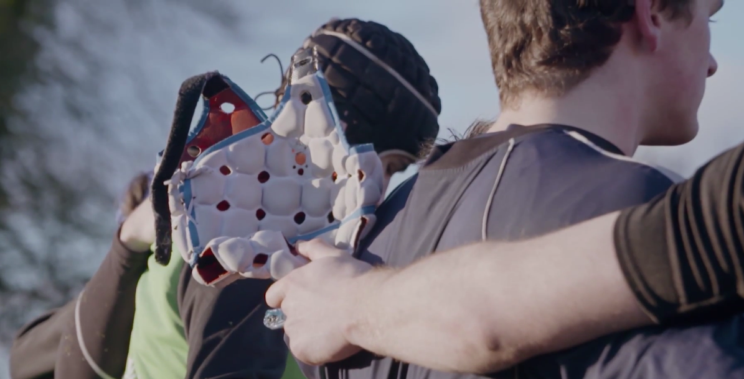
Pledge Form
TO CLONGOWES WOOD COLLEGE
I/We would like to make an annual pledge of:
 €16,665 over 6 years for a total pledge of €100,000
 €10,000 over 6 years for a total pledge of €60,000
 €5,000 for 6 years for a total pledge of €30,000
€3,000 for 6 years for a total pledge of €18,000
Other: A total pledge of € ________________
 annually  quarterly  monthly  one-off
over  three  five  six years  other _______
commencing on (date) __________
Title: Family Name:
First Name:
If this donation is in a joint name, please add the additional name here:
Full Home Address:
Tel. / Mobile:
Email:
PAYMENT DETAILS
My/Our gift will be paid by:
Standing order: Please complete the attached form and return to Clongowes Foundation (not directly to your bank).
Bank transfer: AIB Private Banking, 10 Molesworth St., Dublin 2 . IBAN: IE96 AIBK 9303 9303 0650 45 / BIC: AIBKIE2D
Cheque: Payable to Clongowes Foundation and post to: Clongowes Foundation, FREEPOST, Clane, Co Kildare
Other: Please state __________________
Signature:
Date:
RECOGNITION
I/we consent to be acknowledged in an annual fundraising update
I/we prefer my/our gift to remain anonymous
TAX RELIEF
I/We would like to maximise our gift, allowing Clongowes to claim 31% tax refund on our donation at no extra cost
Yes – Please complete the attached CHY3 Form and return to Clongowes Foundation
No
Please send us more details to the above address
I am a UK tax payer. Please send me/us information on how to get UK tax refund and Gift Aid my/our donation.
Data Protection: Information provided on this form is for internal use by Clongowes Wood College and will be treated confidentially and with sensitivity in accordance with the Data Protection Act. Contact details may be used to keep you up to date with any news, fundraising initiatives or events. If you would like to receive such development related messages please tick the relevant boxes to opt in to the communication channel. Please contact me by:  mail  email  telephone

Slide 2
STANDING ORDER SET UP FORM
Please complete this form and return it to Clongowes Foundation, and not directly to your bank.
To the Manager: ___________________________________________________________________
Bank Name: ___________________________________________________________________
Bank Address: ___________________________________________________________________
I/We hereby authorise and request you to DEBIT my/our account.
Sender BIC: ___________________________________________________________________
Sender IBAN: ___________________________________________________________________
Amount: € _____________________ Amount in words: __________________________
And to CREDIT: Clongowes Wood College Foundation
BIC: AIBKIE2D | IBAN: IE96 AIBK 9303 9303 0650 45
AIB Private Banking, 10 Molesworth St., Dublin 2.
Receivers reference (NAME OF DONOR): ___________________________________________________
Please allow 5 working days prior to first payment
Start date (DD/MM/YYYY): / / 20 __
Frequency (Please X Box)
Monthly
Quarterly
Annually
End date (DD/MM/YYYY): / / 20 __
Please flag this payment with the code “______________” for Clongowes’ future reference.
Signature: ________________ Date: __________________
It shall be understood that the Bank shall not be under any liability for damage or loss caused by any omission to make these payments.
Thank you for your generous support.

